Slide 1

Project (AI101B) Even Semester Session 2024-25
Traffic light control system
Project Supervisor:
Mrs. Komal Salgotra

Slide 2
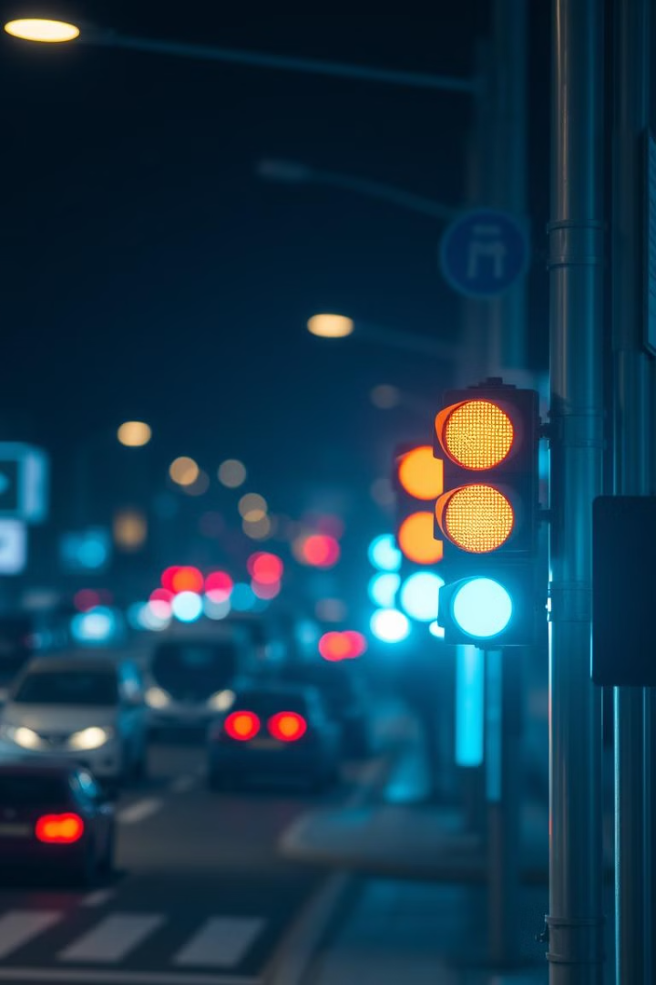
Traffic Light Control System
Presented by:
Shadab Idrishi
Rahul Pratap Singh Chauhan
Shalini Mishra

Slide 3
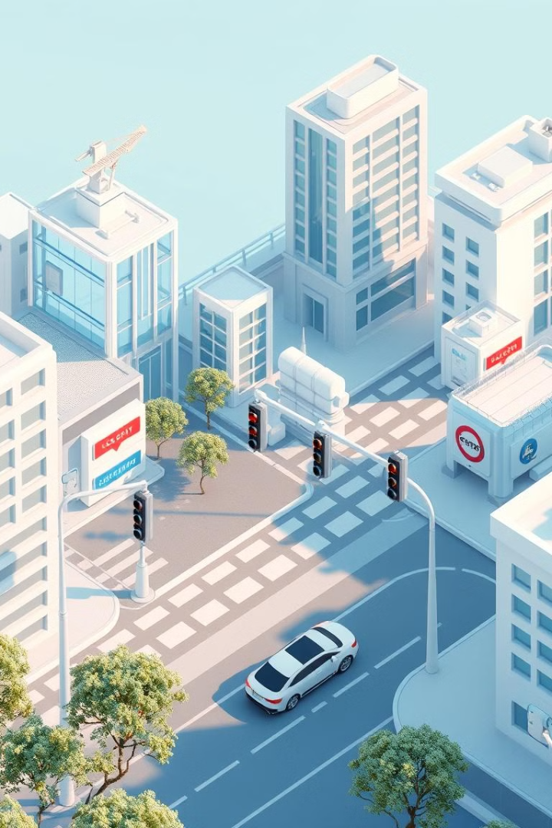
Project Overview
A traffic light control system developed using Python. It simulates real-world traffic scenarios, using automation to ensure smooth traffic flow. This project is aimed at reducing congestion and preventing accidents.

Slide 4
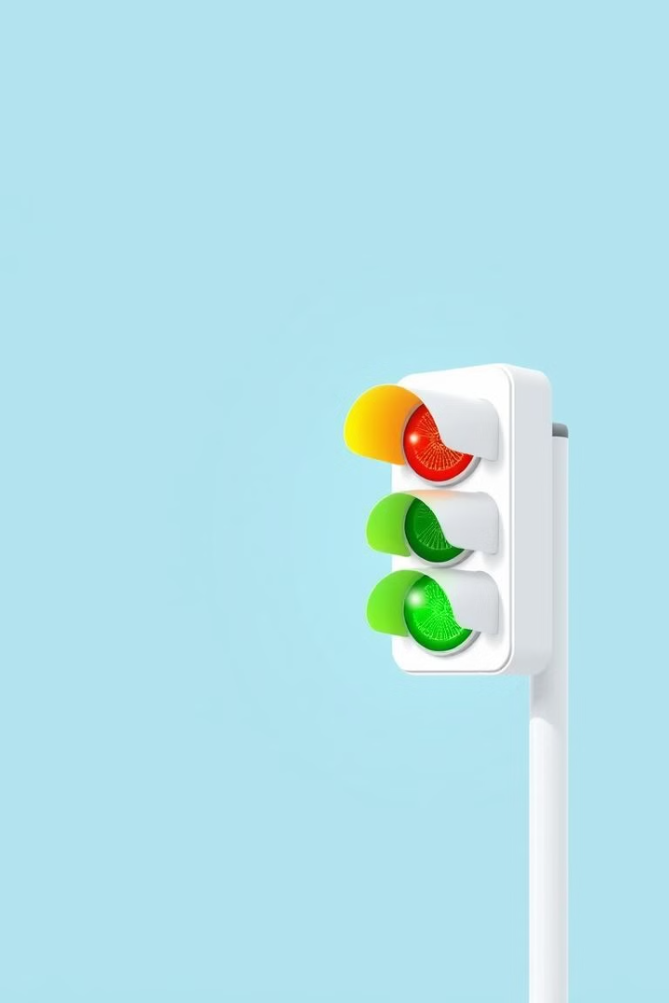
Concept and Features
Uses Python and a graphical user interface for simulation. Implements automatic light transitions (Red, Yellow, Green). Extendable with AI for smart traffic control. Designed to help in urban traffic management.

Slide 5
Modules in the Project
Traffic Signal Controller: Controls light transitions. GUI Interface: Visual representation of signals. Timer Module: Manages signal duration.
Traffic Density Sensor (Optional): Adjusts timing based on traffic.

Slide 6
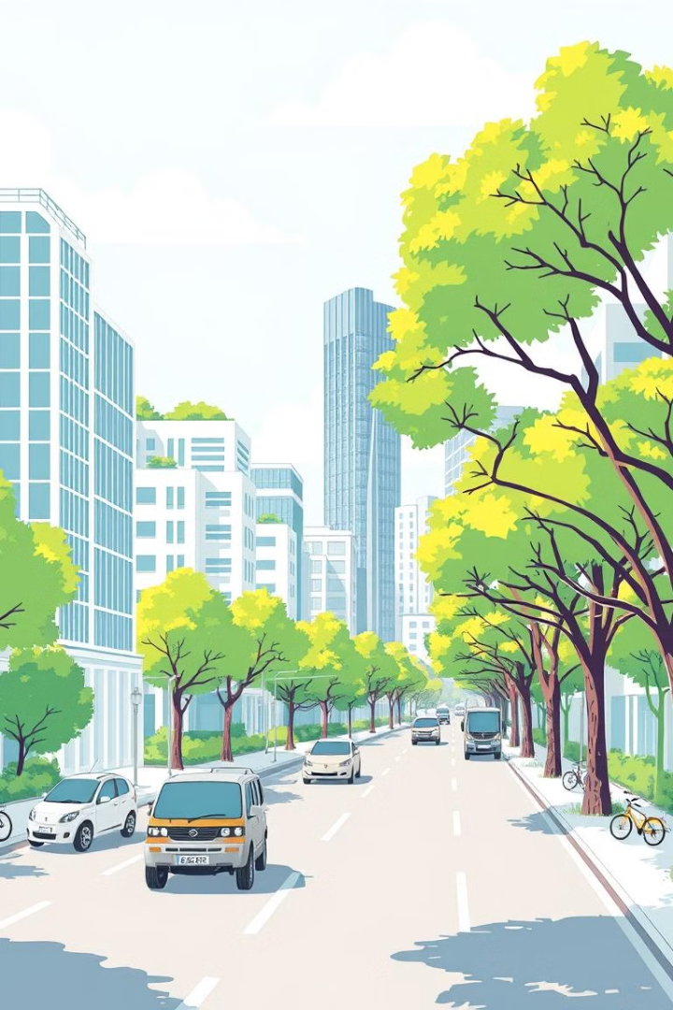
SDG 11 (Sustainable Cities & Communities)
Promotes safe and efficient urban mobility. Reduces fuel consumption and pollution in cities. Enhances smart city infrastructure for better efficiency. Supports sustainable traffic solutions for the future.

Slide 7
Technologies Used
Python: For programming logic and control.Tkinter/Pygame: GUI for visualization.Arduino (Optional): Hardware implementation. AI/ML (Future Integration): Smart traffic predictions.

Slide 8
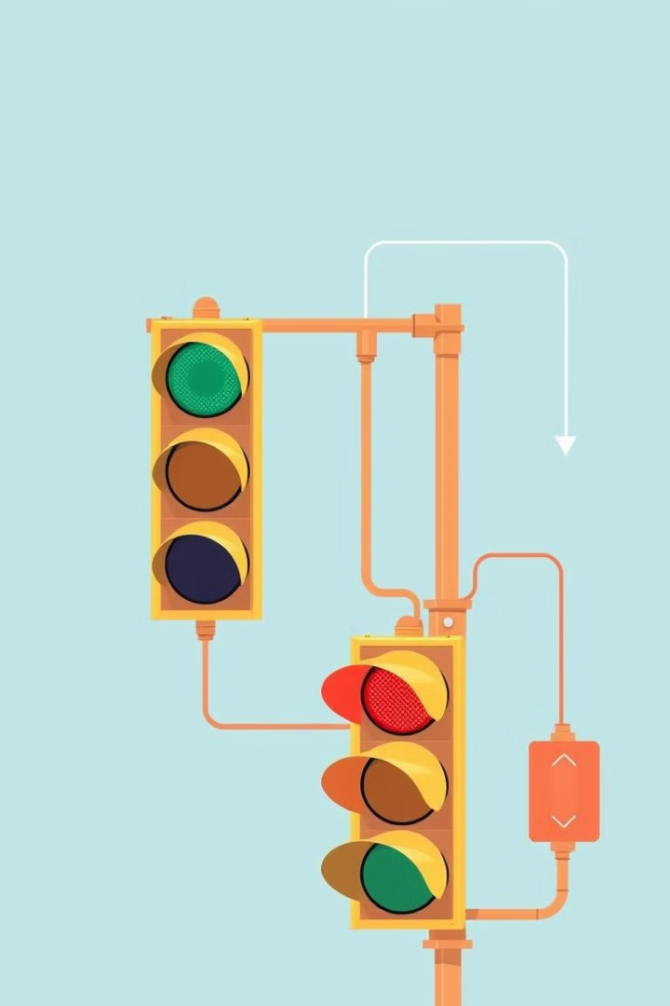
Workflow of the Project
User starts the simulation.
Traffic signals change based on timer.
Optional AI-based traffic detection.
Smooth transition between signals.

Slide 9
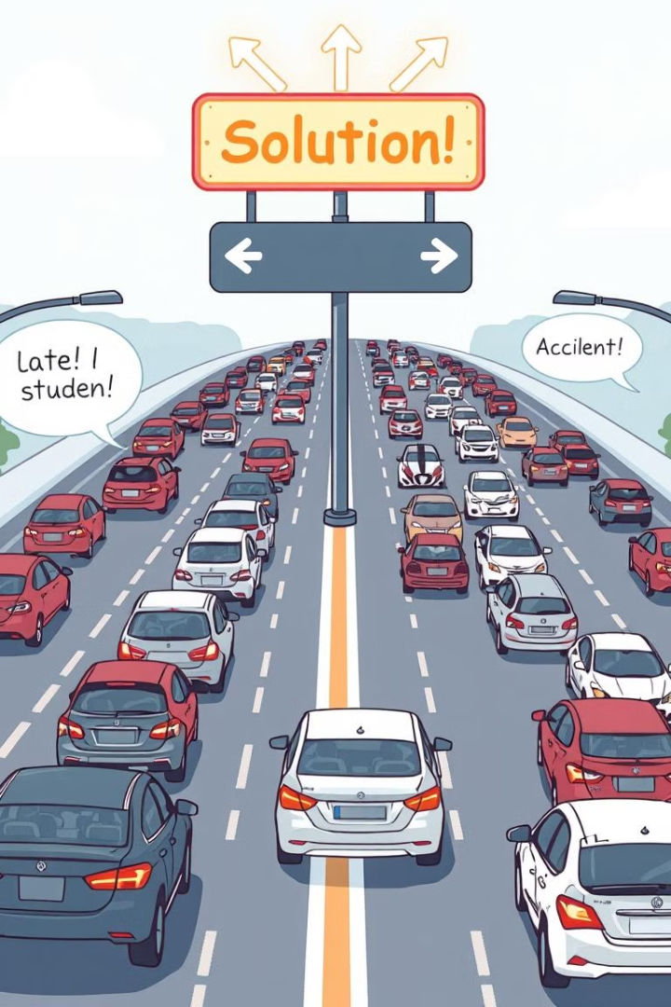
Challenges and Solutions
Timing Issues → Optimized delays for smooth flow.
GUI Optimization → Used Tkinter for better visualization. Traffic Density Adjustment → AI integration.
Hardware Implementation → Prototype tested with Arduino.

Slide 10
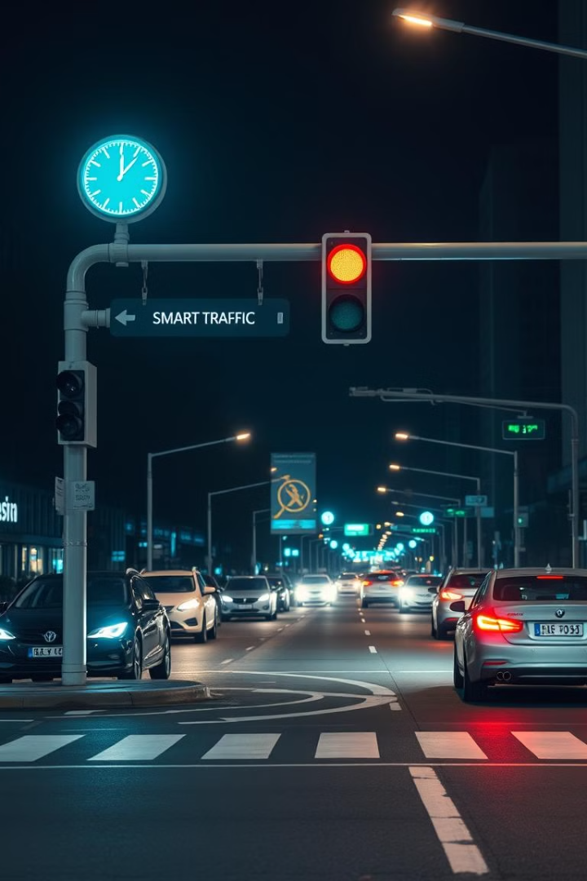
Conclusion
We simulated an efficient traffic light system. This helps manage urban traffic effectively and it can be scaled with IoT and AI in the future. It contributes to smart city development.

Slide 11

Thank You
Questions and Feedback Welcome! Contact us for further details about the project. Thank you for your time and consideration.

